Slide 1

Basic Syntax, Conditional Statements and Loops
SoftUni Team
Technical Trainers
Software University
https://softuni.bg

Slide 2
Table of Contents
Basic Syntax and First Steps
Conditional Statements
if, elif, else
indentation
and, or
Loops
2

Slide 3
Have a Question?
sli.do
#fund-python

Slide 4

Basic Syntax and First Steps

Slide 5
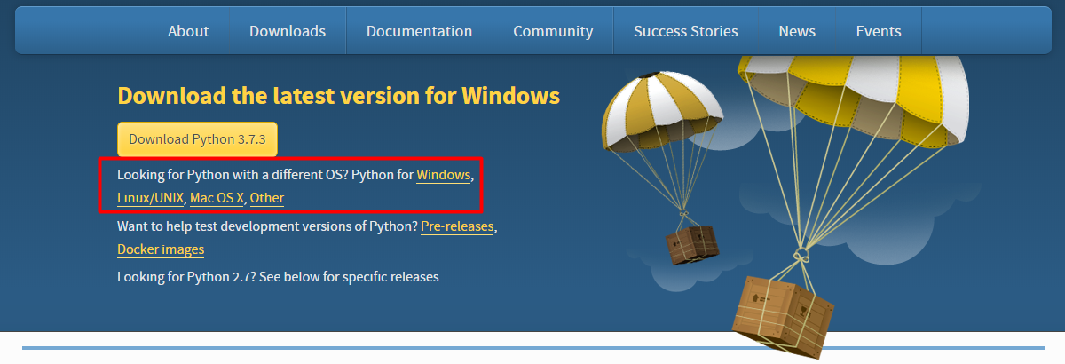
Installing Python
Go to python.org and click the download link depending on your operating system
5

Slide 6
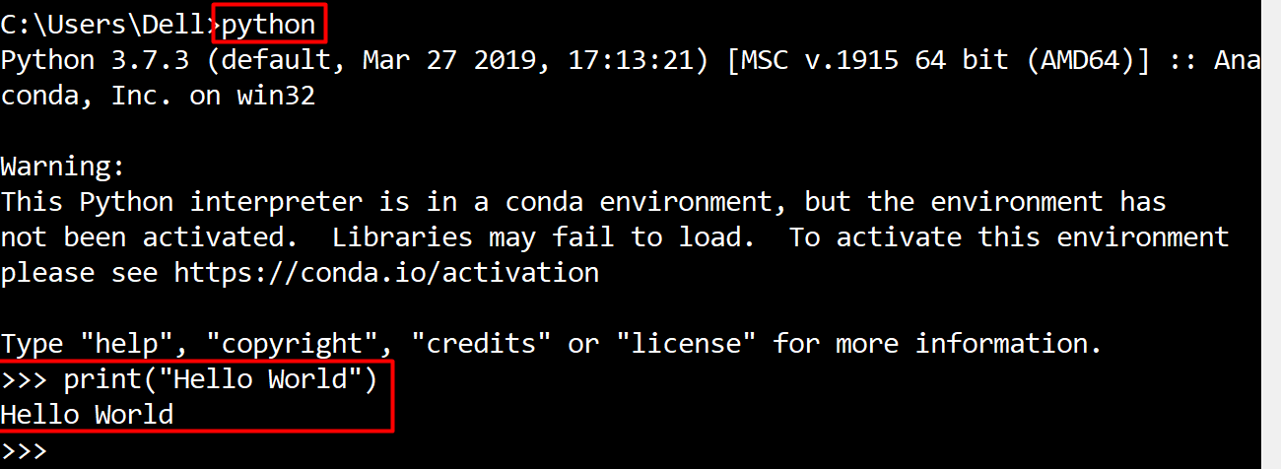
Run Python in Command Prompt
You can code and execute python directly in the command prompt by typing "python" or "py"
6

Slide 7
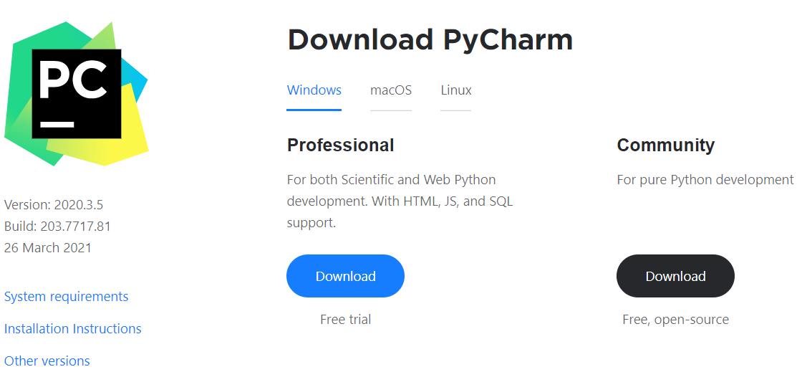
Write Python in IDE
You can also code in Python using IDE (for example: PyCharm)
You can download PyCharm from here: https://www.jetbrains.com/pycharm/download
7

Slide 8
Basic Syntax
Variables – they are way to store information and are characterized by name, type and value
Data types – variables are used to hold different data types
int - integer number: 1, 2, 3, 4, …
float - real number: 0.5, 3.14, -0.5, …
str - string and chars: "a", "Hello", …
bool - boolean: True, False
age = 25
Name
Value
8

Slide 9

Conditional Statements
Conditional Code Execution

Slide 10
The If-Statement
An "if statement" is written by using the if keyword
Python supports the usual logical conditions from mathematics
Equals: a == b
Not Equals: a != b
Less than: a < b
Less than or equal to: a <= b
Greater than: a > b
Greater than or equal to: a >= b
a = 33
b = 200
if b > a:
print("b is greater than a")
10

Slide 11
Indentation
Python relies on indentation, using whitespace, to define scope in the code
Other programming languages often use curly-brackets for this purpose
If statement, without indentation will raise an error
a = 33
b = 200
if b > a:
print("b is greater than a")
11

Slide 12
The Else-Statement
The else keyword catches anything which isn't caught by the preceding conditions
a = 200
b = 33
if b > a:
print("b is greater than a")
else:
print("b is not greater than a")
12

Slide 13
The Elif-Statement
The elif keyword is pythons way of saying "if the previous conditions were not true, then try this condition"
a = 33
b = 33
if b > a:
print("b is greater than a")
elif a == b:
print("a and b are equal")
13

Slide 14
And and Or
The and/or keywords are logical operators. They are used to combine conditional statements
if a > b and c > a:
print("Both conditions are True")
if a > b or a > c:
print("At least one of the conditions is True")
14

Slide 15
Check Number Range
If you want to check whether a number is in a given range, you can use the following syntax
a = int(input())
if 1 <= a <= 10:
print("a is in the range 1 and 10")
1 … 10
15

Slide 16

Problem: Largest of Three Numbers
Write a program which
Reads three whole numbers from the console
Prints the largest number
3
-1
5
5
0
-1
-2
0
16

Slide 17
Solution: Biggest of Three Numbers
first_num = int(input())
second_num = int(input())
third_num = int(input())
if first_num > second_num and first_num > third_num:
print(first_num)
elif second_num > first_num and second_num > third_num:
print(second_num)
else:
print(third_num)
17

Slide 18
Problem: Number Definer
Write a program that
Reads a floating-point number
Prints zero if the number is zero or otherwise prints positive or negative.
Adds small if the absolute value of the number < 1, or large if the number > 1 000 000.
25
positive
0.7
small positive
18

Slide 19
Solution: Number Definer
number = float(input())
if number == 0:
print("zero")
elif number > 0:
if number < 1:
print("small positive")
elif number > 1000000:
print("large positive")
else:
print("positive")
# TODO
19

Slide 20

Loops
Repeating Blocks of Code

Slide 21
For-Loops
A for loop is used to iterate over sequence of iterable types like
tuple
list
other iterable types
The for loop does not require an indexing variable to set beforehand
21

Slide 22
The Range Function
To loop through a set of code a specified number of times, we can use the range() function
for x in range(3):
print(x)
# 0
# 1
# 2
22

Slide 23
The Break Statement
The break statement stops the loop before it has looped through all the items
for x in range(3):
if x == 1:
break
print(x)
0
23

Slide 24
The Continue Statement
The continue statement skips the current iteration of the loop and continue with the next
for x in range(3):
if x == 1:
continue
print(x)
0
2
24

Slide 25
While-Loops
With a while loop we can execute a set of statements as long as the condition is true
Note: remember to increment i, or else the loop will continue forever
i = 1
while i < 6:
print(i)
i += 1
25

Slide 26
Problem: Word Reverse
Write a program that
Receives a single word from a user
Reverses it and prints it
Python
nohtyP
26

Slide 27
Solution: Word Reverse
word = input()
reversed_word = ""
for i in range(len(word) - 1, -1, -1):
reversed_word += word[i]
print(reversed_word)
27

Slide 28
Problem: Number Between 1 and 100
Write a program which
Reads floating-point numbers from the console until it receives a number between 1 and 100 inclusive
When the correct number is received, stop reading and print "The number {number} is between 1 and 100"
-3
0.9
44
The number 44 is between 1 and 100
28

Slide 29
Solution: Number Between 1 and 100
number = float(input())
while number < 1 or number > 100:
number = float(input())
print(f'The number {number} is between 1 and 100')
29

Slide 30

Live Exercises

Slide 31

Summary
…
…
…
We learned how to:
Execute code based on different conditions
Use loops to execute a block of code multiple times on different elements
Stop/skip iterations in loops

Slide 32
Questions?
Notes:
32

Slide 33










SoftUni Diamond Partners

Slide 34


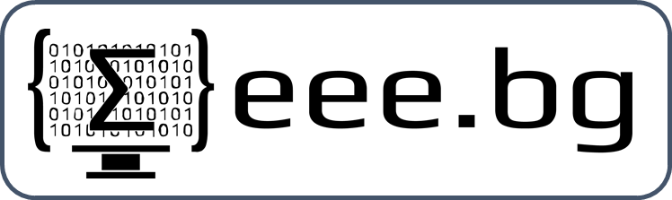
Educational Partners

Slide 35

License
This course (slides, examples, demos, exercises, homework, documents, videos and other assets) is copyrighted content
Unauthorized copy, reproduction or use is illegal
© SoftUni – https://about.softuni.bg
© Software University – https://softuni.bg
Notes:
35

Slide 36
Trainings @ Software University (SoftUni)
Software University – High-Quality Education, Profession and Job for Software Developers
softuni.bg, softuni.org
Software University Foundation
softuni.foundation
Software University @ Facebook
facebook.com/SoftwareUniversity
Software University Forums
forum.softuni.bg
Notes:
36

